Slide 1
Fourier Transform Algorithm

Slide 2
Outline
Fourier Series, DFT
Classification of algorithm
Implementation in Distance Relays
Basic Parameters and Characteristics
Summary of Advantages and Disadvantages
Sources

Slide 3
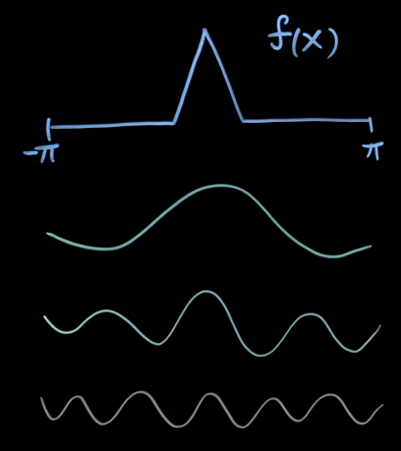
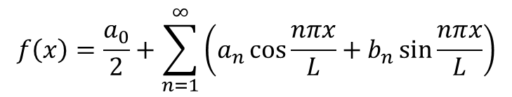
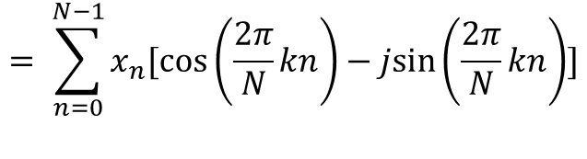
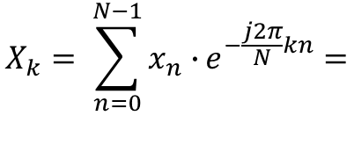
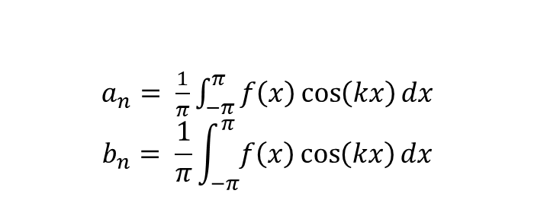
Fourier Series, DFT
Any function = sum of cos and sin with increasing frequency
Fourier Series:
DFT:
$$f\left(x\right)=\frac{a_{0}}{2}+\sum_{n=1}^{∞}{\left(a_{n}\cos{\frac{nπx}{L}}+b_{n}\sin{\frac{nπx}{L}}\right)}$$
$$X_{k}= \sum_{n=0}^{N−1}{x_{n}∙}e^{−\frac{j2π}{N}kn}=$$
$a_{n}= \frac{1}{π}\int_{−π}^{π}{f\left(x\right)\cos\left(kx\right)dx}$
$$b_{n}= \frac{1}{π}\int_{−π}^{π}{f\left(x\right)\cos\left(kx\right)dx}$$
$$= \sum_{n=0}^{N−1}{x_{n}[\cos\left(\frac{2π}{N}kn\right)−jsin\left(\frac{2π}{N}kn\right)]}$$

Slide 4
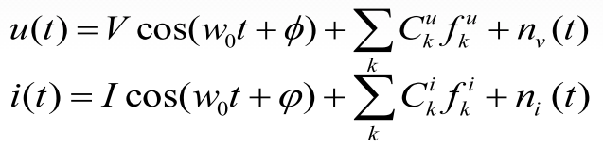
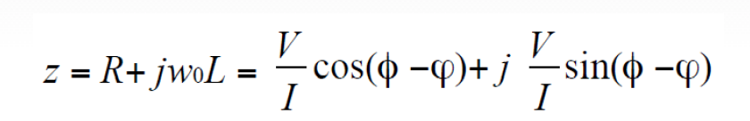
Signal Model
Signal:
Impedance:
Fourier algorithm:
Lumped parameter model
Frequency domain
No optimization

Slide 5




DFT in Relays
Signal x(t) sampled at t = kT. x_{k} - sample
Phasor at fund frequency:
Phasor estimation:

Slide 6

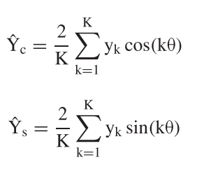
DFT in Relays
Another representation
Signal:
Phasor estimation:

Slide 7


Window size, Harmonics, Noise
Can be implemented in any size window, but usually Full or Half Cycle window
Example for 12 samples per period:
Longer
Less affected by noise
Less affected by DC offset
Immune to harmonics
Affected by FF change
Faster
More affected by noise
Needs external DC offset removal
Sensible to even harmonics
Affected by FF change

Slide 8
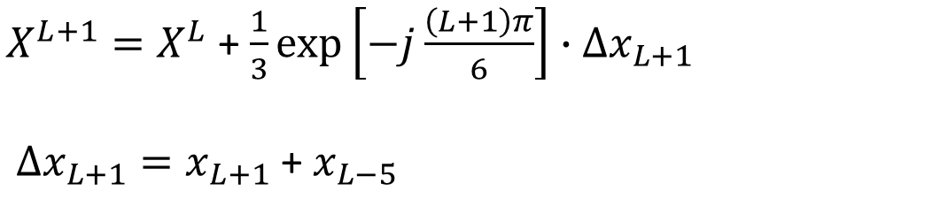
Recursive form
$X^{L}$ is phasor from measurements {x_{L-5}, x_{L-4}, x_{L-3}, x_{L-2}, x_{L-1}, x_{L}}
$X^{L+1}=X^{L}$ + $\frac{1}{3}\exp\left[−j\frac{\left(L+1\right)π}{6}\right]∙∆x_{L+1}$
$∆x_{L+1}=x_{L+1}$ + $x_{L−5}$
Less computations
May accumulate error
Combination of recursive and non-recursive is recommended

Slide 9
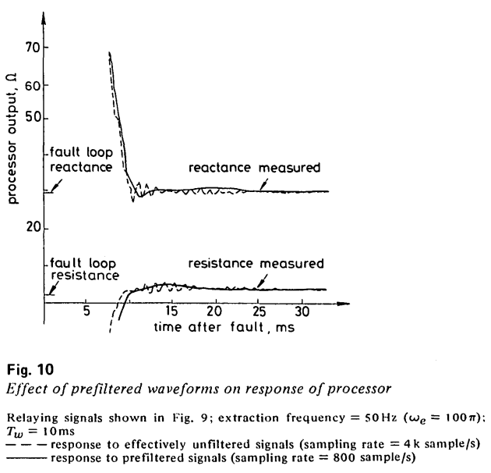
Other characteristics
Requires anti-aliasing filter
Increasing sampling rate does not necessarily lead to better performance
Lower sampling frequency + low-pass filtering = smooth and convergent output

Slide 10
Advantages and Shortcomings
Full and Half on clean wave – same result
Full and Half with noise – Full is more accurate, but is slower
DC offset – rejected by Full, huge error for Half
Harmonics – adverse effect
Method can extract non-fund components
Frequency deviation – phasor swings
The increase in accuracy is not observed by the increased sampling rate
https://github.com/baerashid/Fourier_trasform_in_relaying

Slide 11
Sources
[1] J. G. Gilbert and R. J. Shovlin, "High speed transmission line fault impedance calculation using a dedicated minicomputer," IEEE Transactions on Power Apparatus and Systems, vol. 94, no. 3, pp. 872-883, 1975, doi: 10.1109/T-PAS.1975.31918.
[2] P. Jena, "Phasor Estimation," ed. YouTube: IIT Roorkee, 2018, p. https://www.youtube.com/watch?v=L6Wlm0q14O4.
[3] B. J. Mann and I. F. Morrison, "Digital Calculation of Impedance for Transmission Line Protection," IEEE Transactions on Power Apparatus and Systems, vol. PAS-90, no. 1, pp. 270-279, 1971, doi: 10.1109/TPAS.1971.292966.
[4] G. R. Slemon, "High-Speed Protection of Power Systems Based on Improved Power System Models," CIGRE paper No. 31-09, 1968.
[5] D. University, ed, 2015, p. https://people.duke.edu/~ng46/borland/sampling.htm.
[6] Wikipedia. "Fourier Series." https://en.wikipedia.org/wiki/Fourier_series (accessed 2021).
[7] A. Wiszniewski, "How to Reduce Errors of Distance Fault Locating Algorithms," IEEE Transactions on Power Apparatus and Systems, vol. PAS-100, no. 12, pp. 4815-4820, 1981, doi: 10.1109/TPAS.1981.316443.
[8] Fourier Algorithm implementation for Relay Protection. (2021). Github. [Online]. Available: https://github.com/baerashid/Fourier_trasform_in_relaying
[9] S. M. Brahma, P. L. D. Leon, and R. G. Kavasseri, "Investigating the Option of Removing the Antialiasing Filter From Digital Relays," IEEE Transactions on Power Delivery, vol. 24, no. 4, pp. 1864-1868, 2009, doi: 10.1109/TPWRD.2009.2028802.
[10] S. Brunton, "Fourier Analysis," ed. YouTube, 2020, p. https://www.youtube.com/playlist?list=PLMrJAkhIeNNT_Xh3Oy0Y4LTj0Oxo8GqsC.
[11] J. Carr and R. V. Jackson, "Frequency domain analysis applied to digital transmission line protection," IEEE Transactions on Power Apparatus and Systems, vol. 94, no. 4, pp. 1157-1166, 1975, doi: 10.1109/T-PAS.1975.31950.
[12] H. H. El-Tamaly and A. H. M. El-sayed, "A new technique for setting calculation of digital distance relays," in 2006 Eleventh International Middle East Power Systems Conference, 19-21 Dec. 2006 2006, vol. 1, pp. 135-139.
[13] G. B. Gilcrest, G. D. Rockefeller, and E. A. Udren, "High-Speed Distance Relaying Using a Digital Computer I - System Description," IEEE Transactions on Power Apparatus and Systems, vol. PAS-91, no. 3, pp. 1235-1243, 1972, doi: 10.1109/TPAS.1972.293482.
[14] A. Gómez Expósito, J. A. Rosendo Macias, and J. L. Ruis Macías, "Discrete Fourier transform computation for digital relaying," International Journal of Electrical Power & Energy Systems, vol. 16, no. 4, pp. 229-233, 1994/08/01/ 1994, doi: https://doi.org/10.1016/0142-0615(94)90014-0.
[15] A. T. Johns; and M. A. Martin, "Fundamental Digital Approach to the Distance Protection of E. H. V. Transmission Lines," Proc. IEE, vol. 125, 1979.
[16] M. Kezunovic, "Transmission Line Relaying," in ECEN 679 course materials, ed. eCampus, 2021.
[17] M. Kezunovic, "Foundations of Relaying Algorithms," in ECEN 679 course materials, ed. eCampus, 2021.
[18] M. Kezunovic, "Computer Relays Lectures," in ECEN 679 course materials, ed. eCampus, 2021, p. https://tamu.blackboard.com/webapps/blackboard/content/listContent.jsp?course_id=_223030_1&content_id=_7882402_1.
[19] M. Kezunovic, "Digital Algorithms for Protective Relaying," in ECEN 679 course materials, ed. eCampus, 2021.
[20] D. Lee, Y. Oh, S. Kang, and B. M. Han, "Distance relaying algorithm using a DFT-based modified phasor estimation method," in 2009 IEEE Bucharest PowerTech, 28 June-2 July 2009 2009, pp. 1-6, doi: 10.1109/PTC.2009.5282053.
[21] N. C. Munukutla and D. Rao, "Issues on High Speed Relaying in High Voltage Transmission lines using Full Cycle Discrete Fourier Transform and Phaselet Transform," 01/01 2019, doi: 10.35940/ijitee.B9073.129219.
[22] A. Phadke and J. s. Thorp, Computer relaying for power systems, 2 ed. John Wiley & Sons Ltd, 2009, p. 344.
[23] A. G. Phadke, T. Hlibka, M. Ibrahim, and M. G. Adamiak, "A Microcomputer Based Symmetrical Component Distance Relay," in IEEE Conference Proceedings Power Industry Computer Applications Conference, 1979. PICA-79., 15-19 May 1979 1979, pp. 47-55, doi: 10.1109/PICA.1979.720045.
[24] S. P. Simon, M. S. Kumar, K. Sundareswaran, and C. C. Columbus, "Performance analysis of empirical Fourier transform based power transformer differential protection," in 2016 IEEE International Conference on the Science of Electrical Engineering (ICSEE), 16-18 Nov. 2016 2016, pp. 1-5, doi: 10.1109/ICSEE.2016.7806152.
[25] J. S. Thorp, A. G. Phadke, S. H. Horowitz, and J. E. Beehler, "Limits to Impedance Relaying," IEEE Transactions on Power Apparatus and Systems, vol. PAS-98, no. 1, pp. 246-260, 1979, doi: 10.1109/TPAS.1979.319525.
[26] C. Yu, Y. Huang, and J. Jiang, "A Full- and Half-Cycle DFT-based technique for fault current filtering," in 2010 IEEE International Conference on Industrial Technology, 14-17 March 2010 2010, pp. 859-864, doi: 10.1109/ICIT.2010.5472598.

Slide 12
Thank you

